Slide 1
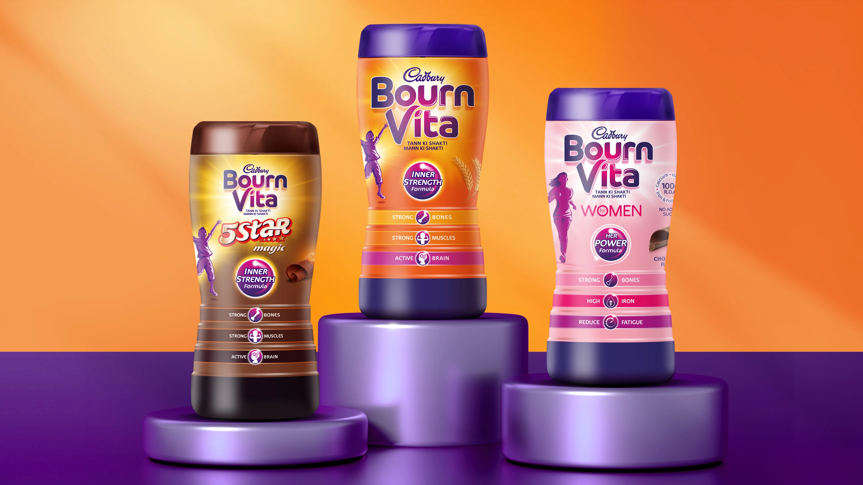

Slide 2

MARKETING MANAGEMENT
BOURNVITA
Prof. AMIT SHUKLA

Slide 3


SEQUENCE
01
BRAND INFO.
GROUP 6
02
CURRENT 4Ps
SAURABH 180696
AMIT 210121
SURENDRA 211083
ASHWANI 231080025
CHANDANA 210529
03
SURVEY & ONLINE REVIEW
04
NEW 4Ps & GAPS
05
VIDEO AD

Slide 4


INTRODUCTION
Cadbury Bourn vita was launched in 1949 in India.
The name is derived from Bournville, the village where the Cadbury factory is located, combined with “vita,” meaning life, reflecting the brand’s focus on vitality and health
Bournvita is a renowed malted chocolate drink mix that has been a staple in households around the world, particularly in india, for over seven decades. It offered a unique combination of health and taste.
The brand of malted and chocolate malt drink mixes sold in Europe and North America. The brand also covers India, Nepal, Nigeria, Ghana, South Africa, Benin and Togo.
Today Bournvita is popular among children and mothers but the success it gained was backed with strategic planning and marketing strategy and no compromise on quality.
Market share - 13-15%

Slide 5

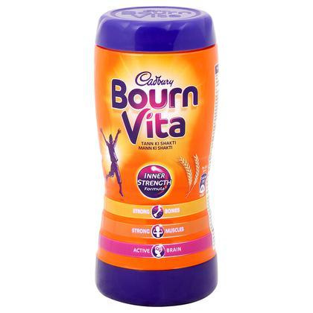
Parent Company: Mondelez International
Overview: Mondelez International, a global leader in snacks, operates in over 150 countries.
Cadbury Acquisition: Acquired in 2010, enhancing Mondelez's chocolate and beverage portfolio.
Legacy: Established in 1824, Cadbury is renowned for its quality and heritage in confectionery.
Global Presence: Mondelez's strong market presence includes brands like Oreo, Toblerone, and Cadbury.

Slide 6
History of Bournvita
Launch: Introduced in India in 1949, Bournvita became a staple health drink.
Name Origin: Named after Bournville, the site of Cadbury's factory in the UK.
Evolution: Adapted with flavors and health benefits to meet changing consumer needs.
Milestones: Expansion to countries like Nepal, Nigeria, and Ghana, reinforcing its popularity.

Slide 7
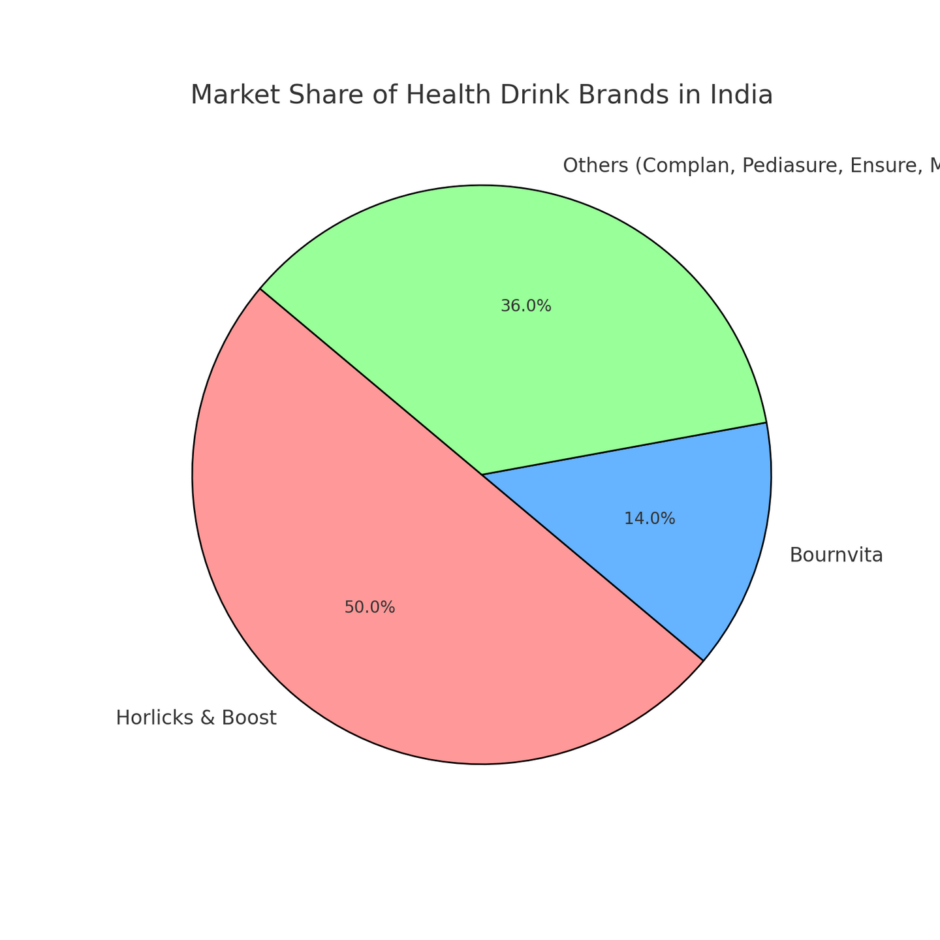

Slide 8
Market Segmentation
Demographic: Targeting children (5-15 years) and health-conscious parents.
Geographic: Focus on urban and semi-urban areas, catering to diverse regions.
Psychographic: Appeals to families prioritizing health and wellness.
Behavioral: Regular users who value nutritional supplements and brand reliability.

Slide 9
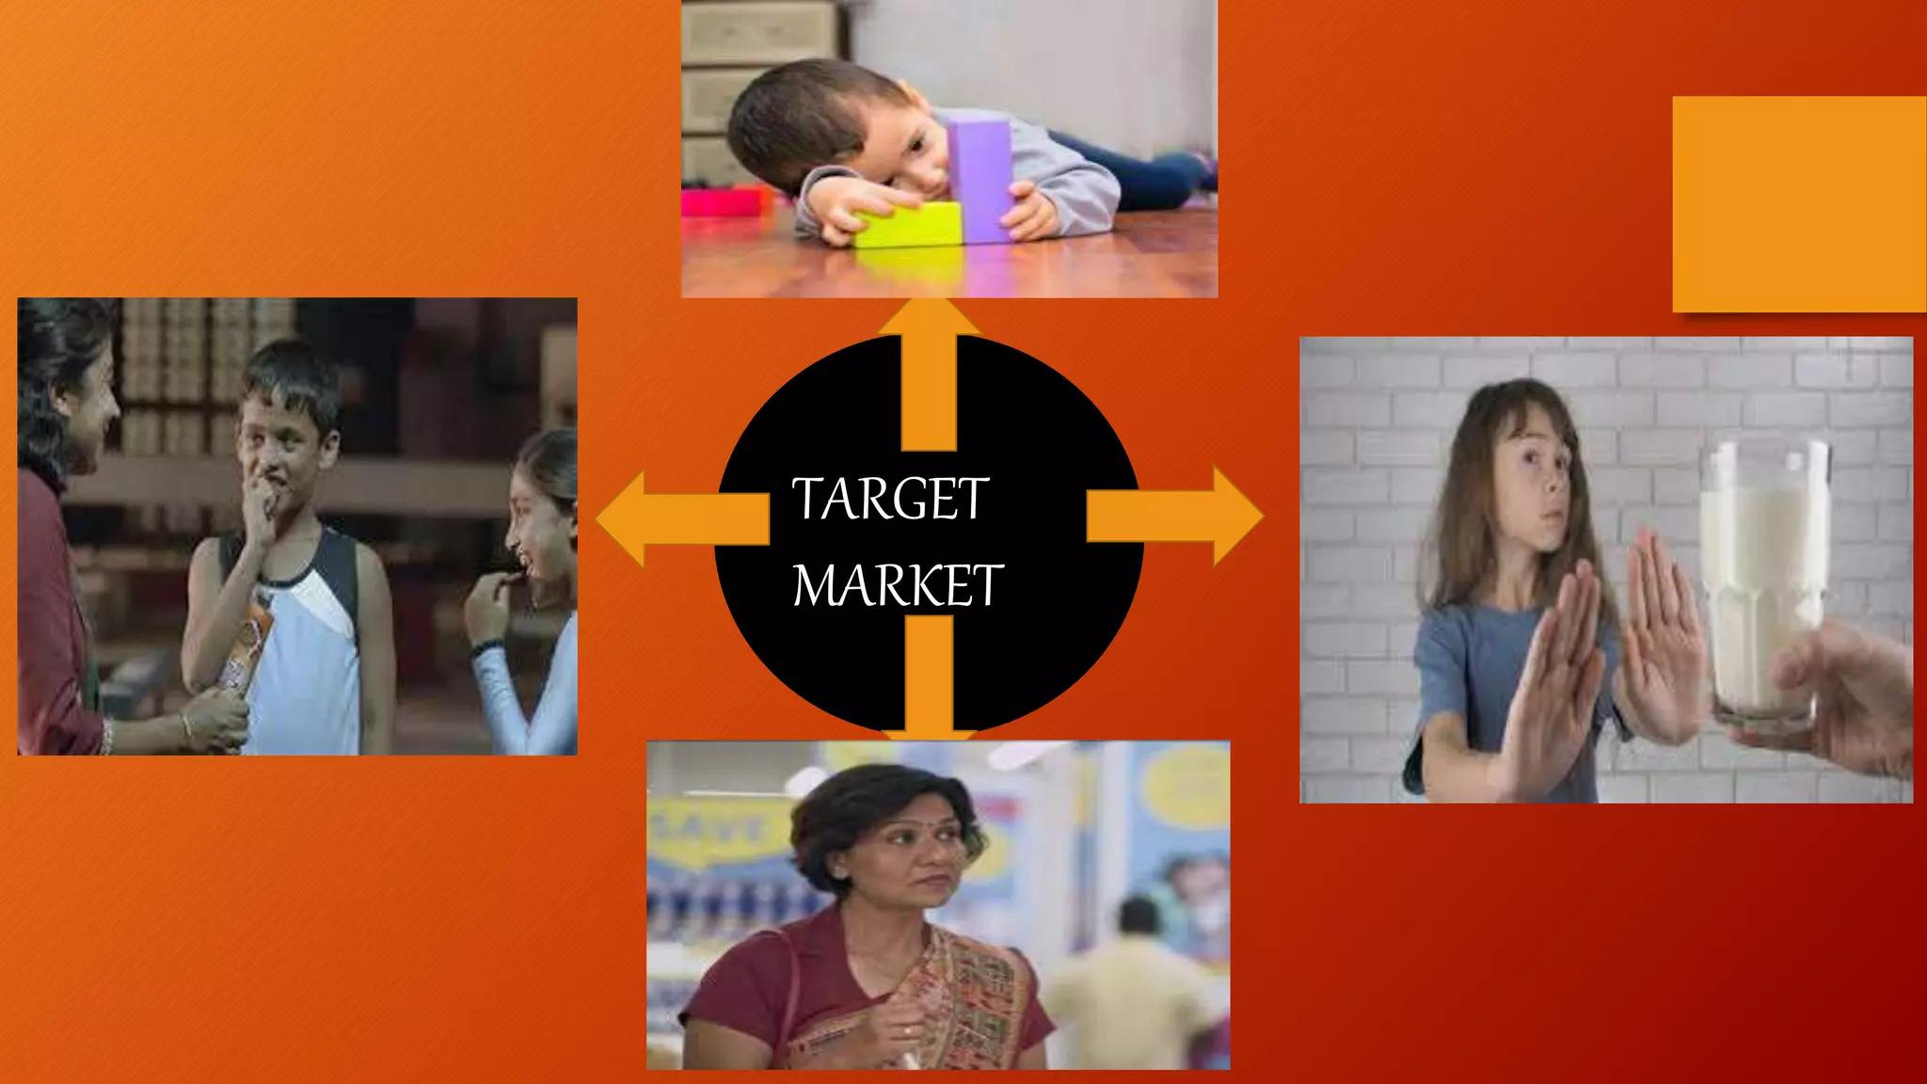

Slide 10
Target Customer
Primary Customers: Parents with children aged 5-15, emphasizing nutrition and growth.
Secondary Customers: Young adults seeking health benefits.
Buying Motivations: Desire for mental and physical development of children.
Consumer Needs: Trust in a brand that offers consistent quality and health benefits.

Slide 11
Brand Strategy
Product Strategy: Emphasis on nutritious ingredients and health benefits.
Marketing Strategy: Emotional advertising focusing on parental care and child success.
Distribution Strategy: Widely available in grocery stores, supermarkets, and online.
Promotional Activities: TV commercials, digital campaigns, influencer partnerships.
Market Share: 13-15% in the milk food drink category, maintaining competitive edge.

Slide 12
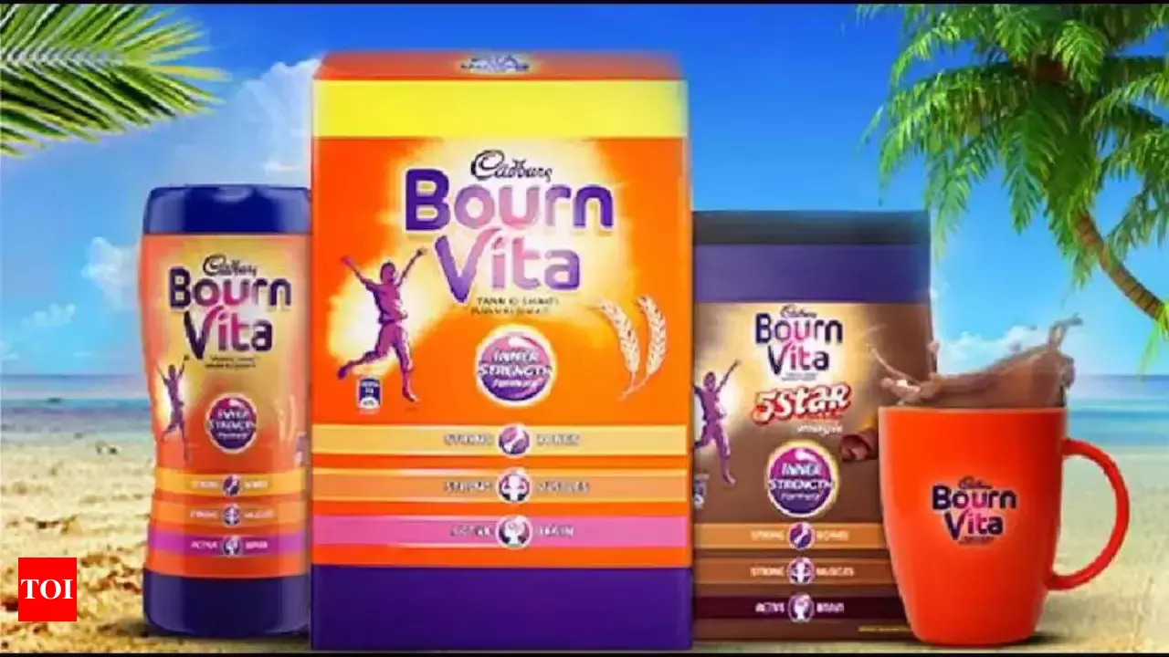

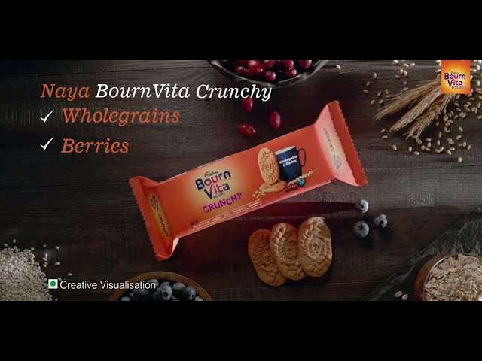
BOURNVITA
4P’s

Slide 13



Bournvita is marketed as a Nutritional Drink that is also a dietary supplement .
It is a Nutritional Drink that nourishes children with
Flavour and Good taste .

Slide 14

As of 2023, Bournvita’s product mix is tailored to different consumer needs, mainly focusing on children’s nutrition (Source):
Cadbury Bournvita 5 Star Magic.
Cadbury’s Bournvita.
Bournvita Li’l Champs.

Slide 15

Bournvita Place Strategy
Bournvita has spread its network in various countries like North America, Europe, Togo, South Africa, Kenya, Ghana, Nigeria, Nepal, and India.
Bournvita has an excellent reach to its customers through well-organized distribution and online advertising channels. It is available in most retail stores, supermarkets, provision stores, and medical stores.

Slide 16

Bournvita’s place strategy, essential for its market presence, includes the following elements:
Bournvita and Market Penetration: Bournvita has successfully expanded its network to various countries globally, including North America, Europe, several African nations, Nepal, and India. This broad reach ensures its availability to a diverse customer base.
Strong Distribution Network: Utilizing an efficient distribution channel, Bournvita is available in retail stores, supermarkets, provision stores, and medical shops, making it easily accessible to consumers.

Slide 17
1.Indirect Sales Strategy: Bournvita uses an indirect sales approach involving distribution centers, wholesalers, and retailers to reach its consumers in different locations.
2. Online Sales Presence: Bournvita has also established a presence on e-commerce websites to cater to the millennial market, allowing consumers to purchase products online.
3. Utilization of Parent Company’s Infrastructure: Leveraging its parent company’s strong brand presence and logistics support, Mondelez Company’sonal, Bournvita effectively reaches a wide audience.

Slide 18
Bournvita Pricing Strategy
Bournvita is projected as a healthy drink with lots of vitamins and nutritional value that is important for children.
It is the housewife who, in most cases, makes the purchase, and when it comes to children, she will not compromise on the product, irrespective of prices.
Bournvita has adopted a higher price range than its competitors but has projected its product as having better nutritional values.
This is the main reason for the success of its pricing policy.

Slide 19
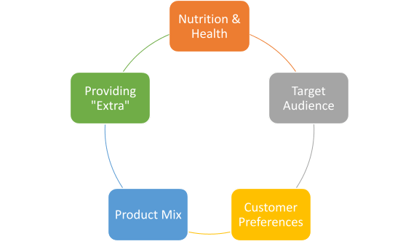

Slide 20

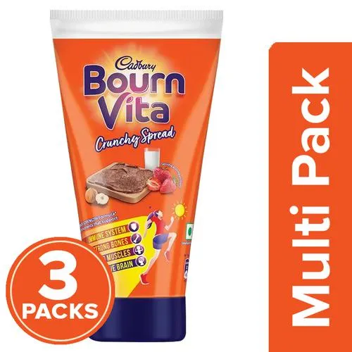
Bournvita’s pricing strategy balances maintaining a premium brand image and being accessible to its target market. The brand leverages its reputation Bournvita’suality to justify its price point while staying competitive in the mother, health, and nutrition segments.

Slide 21

Bournvita Promotion Strategy
A good advertising strategy and policy takes a brand forward as it increases awareness about the products in the minds of consumers. It has re-invented itself periodically regarding distribution, promotion, products, and packaging. Although its actual consumer is children, it has targeted women for promotional activities as it realizes that a mother is going to purchase this drink. In most of its commercials, the advertisers use the mother and her child.

Slide 22

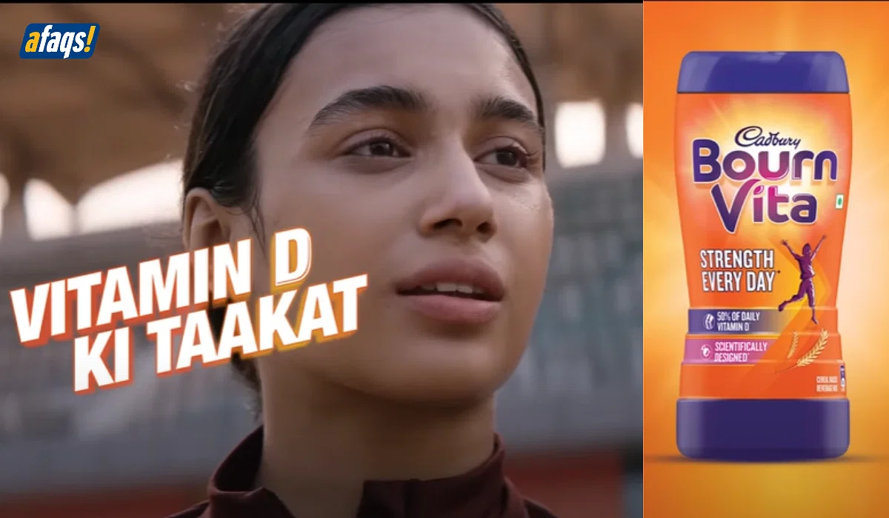
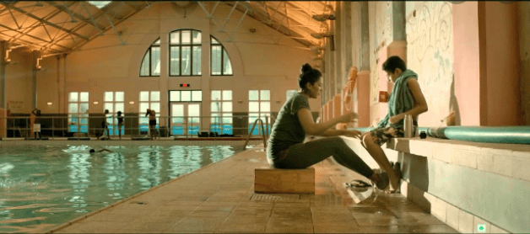

Slide 23
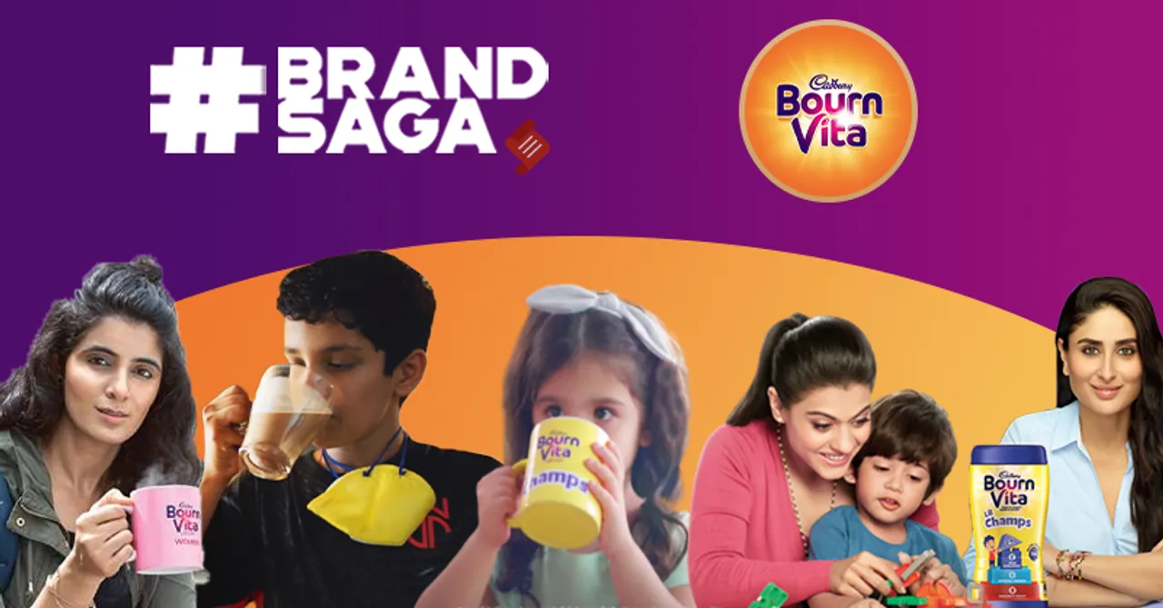

Slide 24
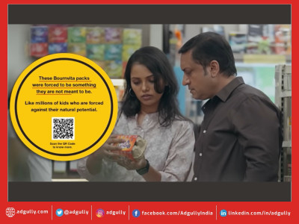
Bournvita’s New Promotional Strategy
As a society, we’ve always dictated what our kids’ futures should be. Even though we have their best interests at heart, we force our kids down a particular career path. They frequently disregard their happiness and natural inclination.
It’s time to stop forcing kids. It’s time to show #FaithNotForce

Slide 25

#TayyariJeetKI

Slide 26
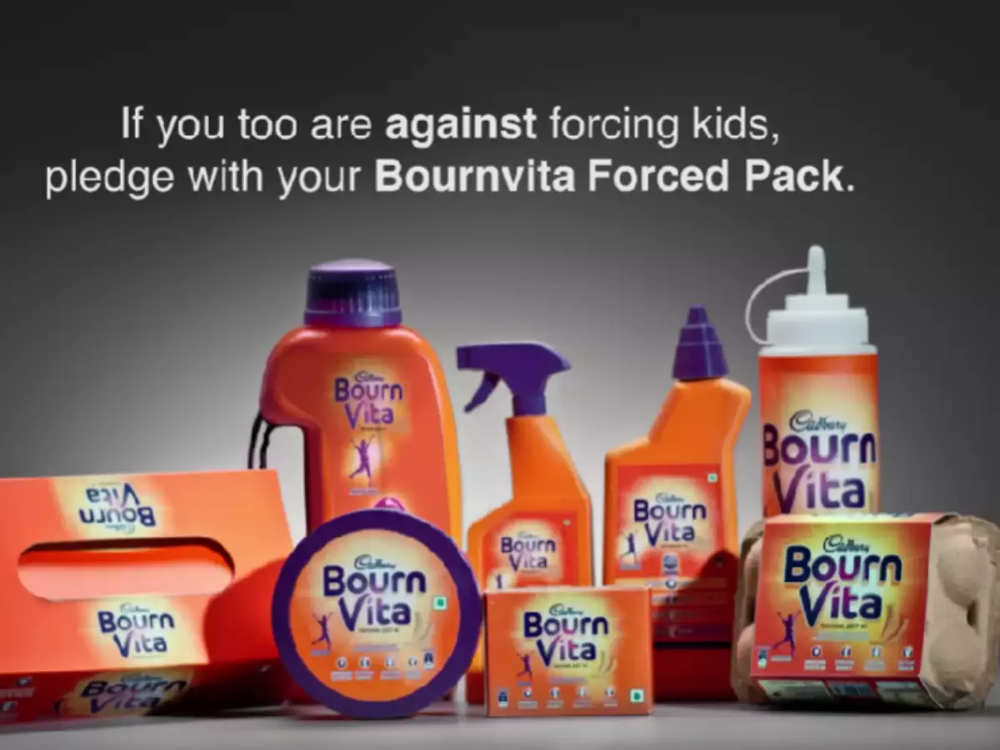
#FaithNotForce

Slide 27

Customer/Consumer survey for Bournvita

Slide 28


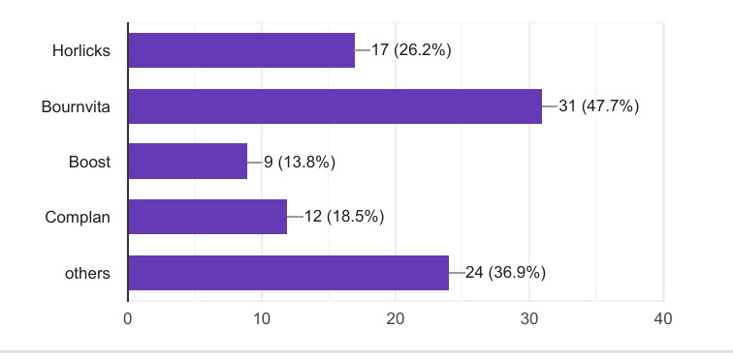
Customer/Consumer survey for Bournvita
Which among the following products you have mostly used ?

Slide 29
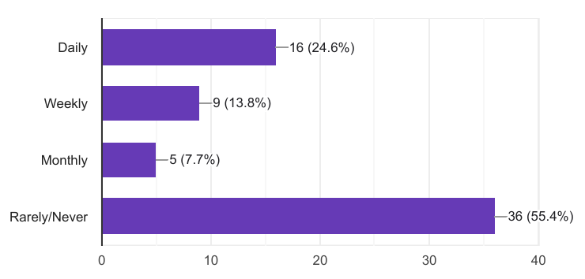
Customer/Consumer survey for Bournvita
How often do you consume Bournvita ?

Slide 30
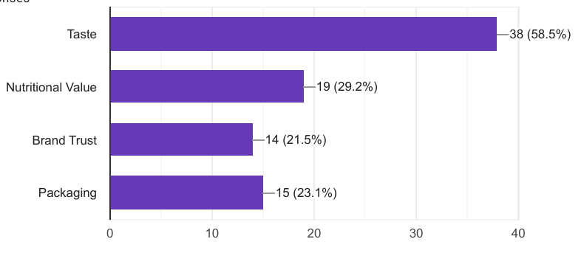
Customer/Consumer survey for Bournvita
What do you like most about Bournvita?

Slide 31
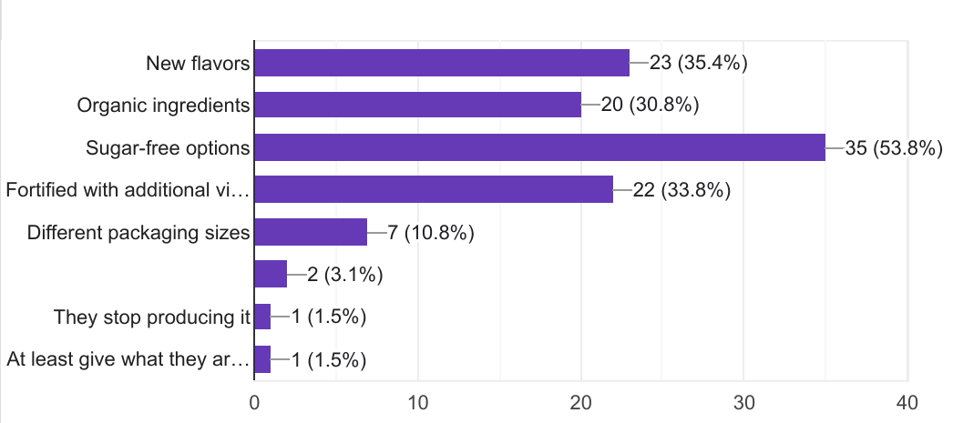
Customer/Consumer survey for Bournvita
What additional features or changes would you like to see in Bournvita? (Select all that apply)

Slide 32
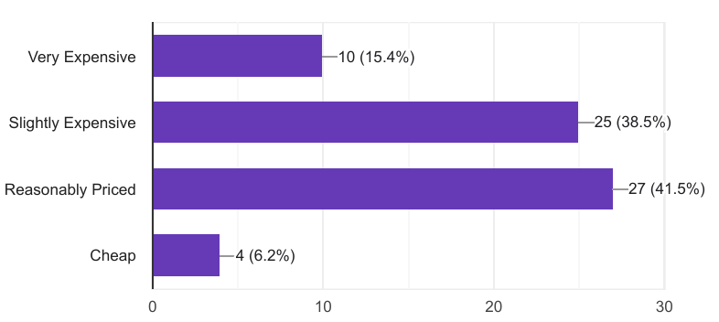
Customer/Consumer survey for Bournvita
How do you perceive the price of Bournvita compared to other health drinks?

Slide 33
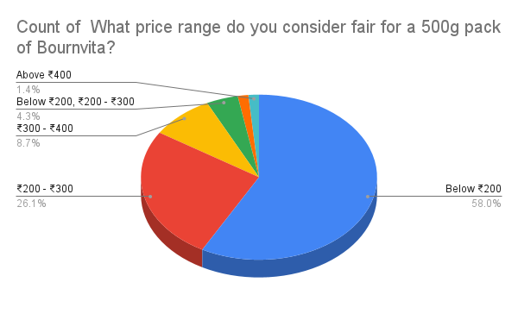
Customer/Consumer survey for Bournvita
What price range do you consider fair for a 500g pack of Bournvita?

Slide 34
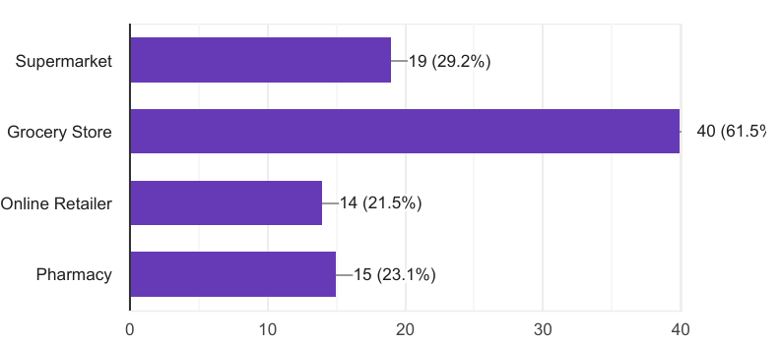
Customer/Consumer survey for Bournvita
Where do you usually purchase Bournvita?

Slide 35
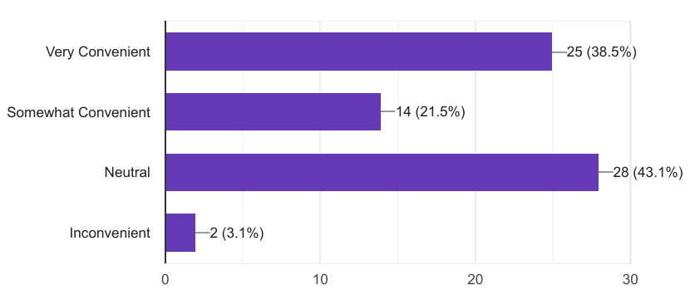
Customer/Consumer survey for Bournvita
How convenient is it for you to find and purchase Bournvita?

Slide 36
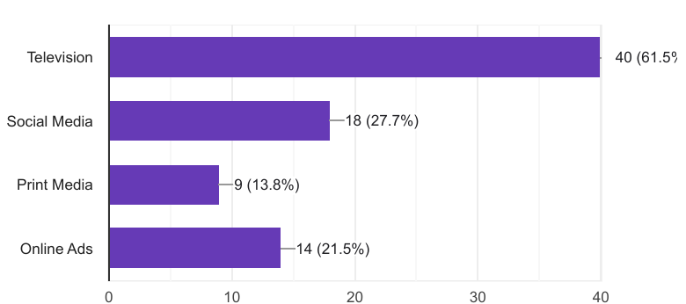
Customer/Consumer survey for Bournvita
Which advertising channel influences you the most to buy Bournvita?

Slide 37
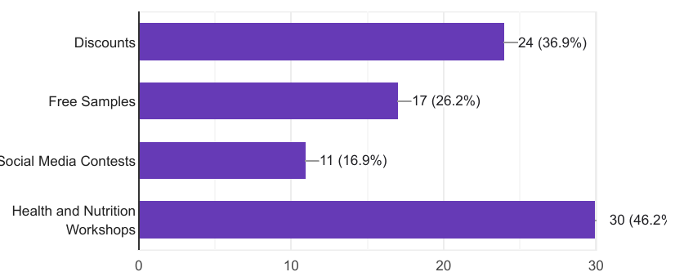
Customer/Consumer survey for Bournvita
What kind of promotional activities would interest you the most?

Slide 38
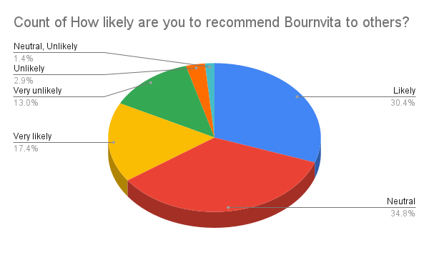
Customer/Consumer survey for Bournvita
How likely are you to recommend Bournvita to others?

Slide 39
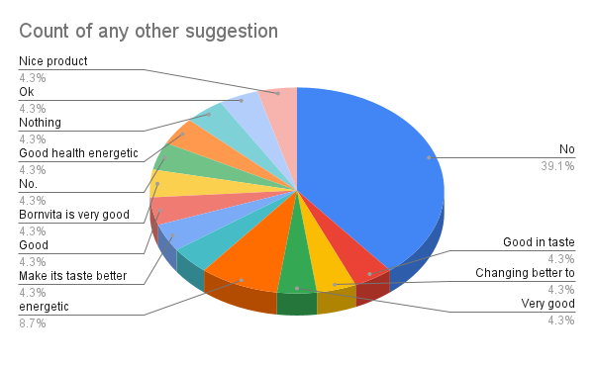
Customer/Consumer survey for Bournvita

Slide 40




Online Reviews
Repositioning
Stratergy
New 4Ps
Video Ad

Slide 41
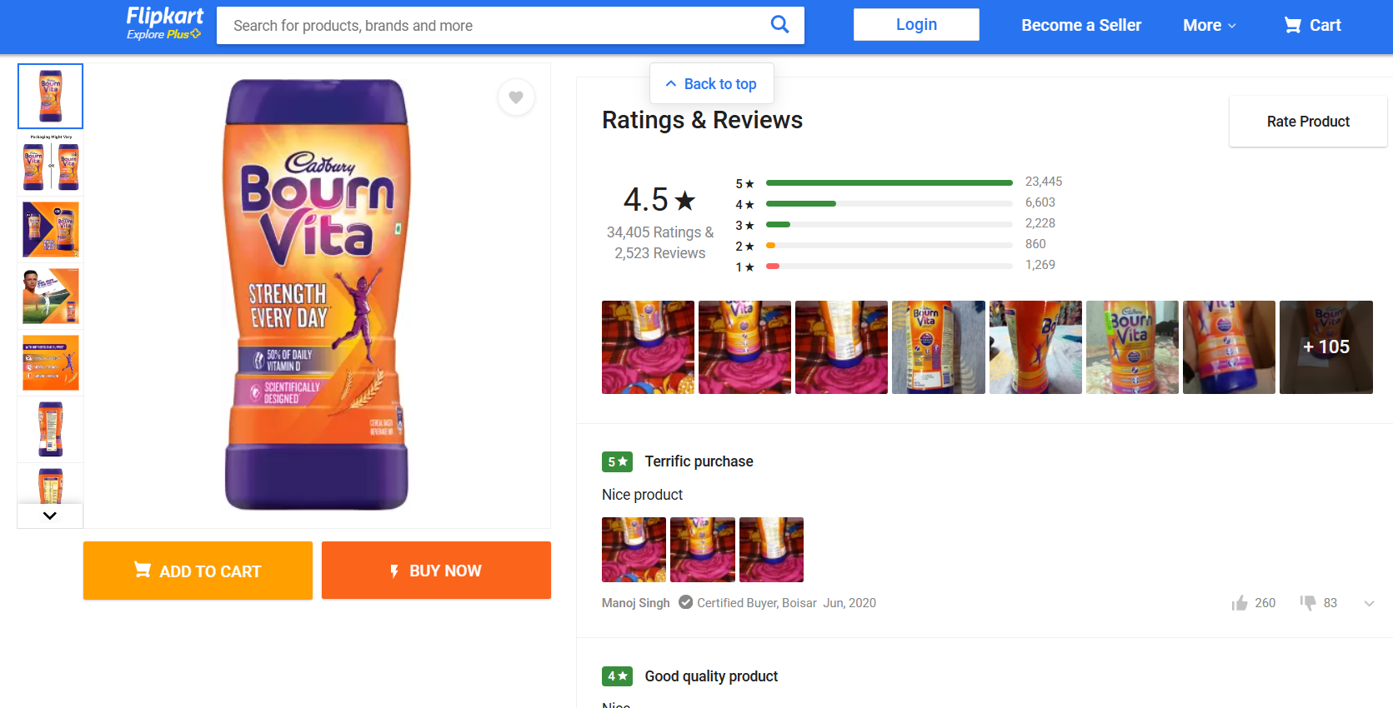

‘’Company should try to reduce sugar content - Harmful for children’’
‘’Average taste along with too much sugar in ingredients. Boost is far far better than this’’
‘’It's okay, you should buy this for your kids, it's not highly priced, so can go for this product’’
‘’This is not a actual Bournvita powder ,is totally duplicate product. Wastage of money’’
‘’ Expired Product received ‘’
‘’The outer packaging is good but the product is totally damaged all the product, the bournvita is not in powder form it becames stones ‘’

Slide 42



PRODUCT
Flavor and Sugar free product: Maintain the taste that customers love while exploring new flavors and possibly introducing a low-sugar variant for health-conscious consumers or maintains a low sugar content while preserving its delicious taste.
Organic Ingredients & Additional Vitamins: Incorporate organic ingredients to enhance the nutritional value and appeal to health-conscious consumers. Fortify Bournvita with extra vitamins to boost its health benefits and appeal as a nutritious choice.

Slide 43
PRICE
Current Price Adequacy: Maintain current pricing as perceived adequate.
Competitive Pricing: Ensure pricing is competitive with other similar products like Horlicks, Boost, and Complan.
Parents POV : It is believed that when it comes to taking care of their kids' nourishment, parents don't look at the price tag.

Slide 44
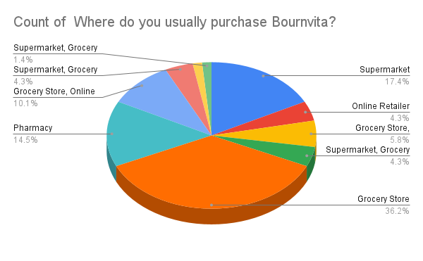
PLACE
Offline Success: Continue successful offline distribution.
Exclusive Online Platform: Establish a dedicated website for direct sales of Bournvita.
Direct Delivery Service: Utilize trusted delivery partners for secure product delivery.
Benefits: ensure customers receive authentic Bournvita products directly from the brand's platform and Offer a subscription option for regular Bournvita purchases.

Slide 45
PROMOTION
Enhanced Social Media Presence: Increase engagement with regular posts, including health tips and interactive content. Run targeted online ads before exam seasons.
Health-Centric Messaging: Highlight the health benefits of Bournvita, emphasizing that neglecting this product may impact overall well-being.
Festive Season Engagement: Organize workshops, social media contests, and offer temporary discounts during festive seasons to attract and retain customers.

Slide 46





REPOSITIONING STRATERGY
Product
Promotion
Place
Introduce new flavors and maintain sugar-free options for Bournvita.
Incorporate organic ingredients and additional vitamins to enhance nutritional value.
Focus promotional efforts on increased social media presence and targeted ads.
Establish an exclusive online platform for direct Bournvita sales.

Slide 47
THANKS

Slide 48
ANY
QUESTIONS

